Slide 1
Fault Tolerance
Reliable System from Unreliable Components

Slide 2
A good programmer is someone who looks both ways before crossing a one-way street.
— Doug Linder, systems administrator.

Slide 3
The U.S national archives
U.S. National Archives and Record Admin
  Preserve electronic records e.g. email
  Daily incremental backups, periodic complete backups, audit logs for tracking actions
June 18-21, 1999, 43,000 emails disappeared
  The audit log had been turned off for better performance
  The contractor’s employees never backup
    Archives never verify the existence of backup copies
Lesson
  Avoid rarely used components, must be tested periodically

Slide 4
Hospital operating room in Newark, New Jersey
Hospital operating room
  With three backup generators
August 14, 2003
  A widespread power grid failure
  One backup generator caught fire from an oil leak
  Another backup generator shut down due to overload
  Hospital engineering turned off many circuit
    Main power was interrupted to the OR
Lesson
  A rarely used component may not have been maintained properly
  Human makes mistakes

Slide 5
World-Flight of Northwest airline
World-Flight
  Manages flight dispatching database
  Manages e-mail between dispatch center and all Northwest airplanes
  Provided data to other systems for passenger check-in and the airline’s web site
Northwest airline
  Contracted with U.S. West to provide fiber-optic links
    Linking to Northwest serves, Weather Bureau, Internet, etc.
    Each primary link with a backup link, automatically switch

Slide 6
World-Flight of Northwest airline
2:05 p.m. on March 23, 2000
  All communications dropped out
  Six cables were accidentally bored through
    Both primary and secondary!
  Pilots resorted to manual procedures
    Radio links were used
  125 flights had to be cancelled
Lessons
  MTTF depend on that replicas are independent
  FT measuring is difficult to test

Slide 7
The fault-tolerance design process
Fault-avoidance
  Build entirely of components that are reliable
  Not practical, at least for large N in (1-p)^{N}
Fault-tolerance
  1. Begin to develop a fault-tolerance model (8.3):
    Identify every potential fault
    Estimate the risk of each fault, as in Section 8.2
    Where the risk is too high, design methods to detect the resulting errors

Slide 8
The fault-tolerance design process
2. Apply modularity to contain the damage from the high-risk errors
3. Design and implement procedures that can mask the detected errors, using the tech in 8.4
  Temporal redundancy. Retry using the same components
  Spatial redundancy. Have different components do the operation
4. Update the fault-tolerance model to account for those improvements
5. Iterate the design and the model until the probability of untolerated faults is low enough that it is acceptable

Slide 9
The fault-tolerance design process
6. Observe the system in the field
  Check logs of how many errors the system is successfully masking. (Always keep track of the distance to the edge of the cliff)
  Perform postmortems on failures and identify all of the reasons for each failure
7. Use the logs of masked faults and the postmortem reports to revise and improve the FT model and reiterate the design
Deciding a risk of failure is “unacceptable high” or “probability of an untolerated fault is low enough that it is acceptable”
  Different application requirements can lead to different approaches
  Tradeoff
  E.g. PC vs. space-flight guidance

Slide 10
Principles
Safety-net: be explicit
  Get all of the assumptions out on the table
Design for iteration
  Hard to estimate probabilities of failure
Safety margin principle
  Monitor how often errors are masked
Keep digging
  Always look beyond the first
Adopt sweeping simplifications
  Complexity increases the chances of mistakes

Slide 11

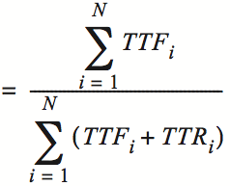
Availability and MTTF
TTF: Time to failure
TTR: Time to repair

Slide 12



MTTR & MTBF
MTBF: mean time between failure
  One can reduce down time by reducing MTTR or by increasing MTBF

Slide 13
Measuring MTTF
Two purposes
  Evaluating & predicting
Measuring MTTF
  The more reliable, the longer it takes to evaluate
  Not measure directly
  Use proxies to estimate its value
One way to measure “MTTF”
  E.g. 3.5-inch disk’s MTTF is 300,000 hours (34y)
  Guess: ran 1,000 disks for 3,000 hours and 10 failed, then invert the failure rate
  If the failure process were memoryless, then OK
  “expected operational lifetime” is only 5 years

Slide 14
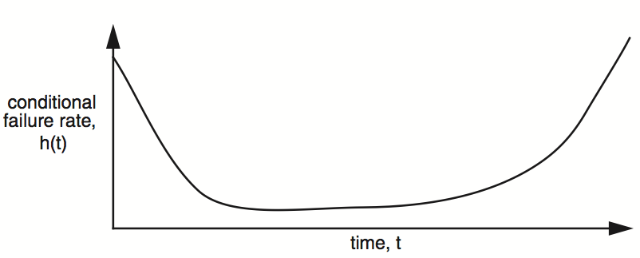
Measuring MTTF
Bathtub curve
  Infant mortality: gross manufacturing defects
  Burn out: accumulated ware and tear cause failure
  Burn in: run for a while before shipping

Slide 15

Reliability functions
h(t): conditional failure rate, e.g. bathtub curve
The reliability, R, of a module is defined as:
f(t): unconditional failure rate

Slide 16



Reliability functions
Once f(t) is at hand, one can calculate MTTF:
Memoryless reliability function
The expected value of the inverse is not equal to the inverse of the expected value
  They are equal only in memoryless distribution

Slide 17
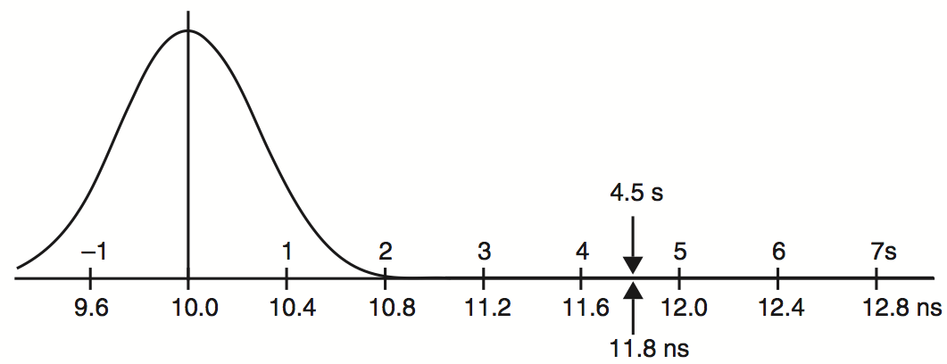
Standard deviation representation
Propagation time of gates
Ensure 4.5 σ reliability
11.8 nanoseconds is the tolerance

Slide 18
Measuring fault tolerance
Failure tolerance
  The number of failures of its components that a system can tolerate without itself failing
  E.g. a memory system with single-error correction has a failure tolerance of one bit
Remaining failure tolerance
  Monitoring is important (safety margin)
Better described as a vector
  E.g. power company tolerates the failure of up to 15% of its generating capacity, as the downing of up to 2 of its lines

Slide 19
Learning curve
Learning curve
  The first components coming out of a new production line tend to have more failures
  Result of design of iteration
Satellite VS. ground-based storage system
  34 years is meaningful only if replacing is easy
Accelerated aging
  Amplifying the cause that dominants
  E.g. store CD at various temperatures for months

Slide 20
Availability
Counting the number of nines
  E.g. 99.9% has 3-nines availability
  Often used in marketing
Corresponding down time
  E.g. 3-nines -> 8 hour/year
  E.g. 5-nines -> 5 min/year
  E.g. 7-nines -> 3 sec/year
  Without any information about MTTF
More fine-grained
  Fail-soft, as in 8.3

Slide 21
Tolerating active faults
Responding to active faults
  Do nothing: let higher layer solve the failure
    The more layers, the more difficult
  Be fail-fast: report the problem
    e.g. Ethernet stops sending and broadcasts when collision
  Be fail-safe: transfer incorrect values to acceptable ones
    e.g. blinking red light in all directions
  Be fail-soft: continues to operate with degradation
    e.g. airplane with three engines continues to fly if one has failure
  mask the error: makes incorrect value right

Slide 22
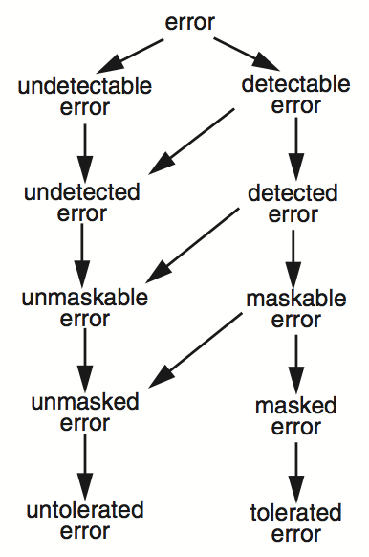
Error classification
Mostly, detect a fault by detecting an error
  A detectable error
  A maskable error
    Tolerated
  An untolerated error
    Undetectable, undetected, unmaskable, unmasked
    Usually leads to a failure

Slide 23
Fault tolerance models
1. Analyze the system
  Categorize detectable errors and undetectable errors
  This stage, detectable or not, all errors are untolerated
2. For each undetectable error
  Evaluate the probability
  If not negligible, modify system design to make the error reliably detectable
3. For each detectable error
  Implement a detection procedure
  Reclassify the module in which it is detected as fail-fast

Slide 24
Fault tolerance models
4. For each detectable error
  Devise a way of masking it
  Reclassify this error as a maskable error if OK
5. For each maskable error
  Evaluate its probability, cost of failure, cost of masking
  If worthwhile, implement the masking method and reclassify as a tolerated error

Slide 25
Two questions
Is the error list complete and the probability realistic?
  Different real-world experiences, different models
  A new tech, or an old tech in new environment, may create surprises
  A wrong judgment can lead to wasted effort
Is the algorithms, procedures, implementations complete and correct?
  Separate the classes of questions
  Ask “Are you questioning the correctness of my recovery algorithm or my model of what may fail?” first

Slide 26
Systematically applying redundancy
Masking error
  Analog system designer: margin
  Digital system designer: redundancy
Outline
  Coding: incremental redundancy
  Replication: massive redundancy
  Voting
  Repair

Slide 27


Coding: incremental redundancy
Forward error correction
  Perform coding before storing or transmitting
  Later decode the data without appealing to the creator
Hamming distance
  Number of 1 in A ⊕ B , ⊕ is exclusive OR (XOR)
  If H-distance between every legitimate pair is 2
    000101, can only detect 1-bit flip
  If H-distance between every legitimate pair is 3
    Can only correct 1 bit flip
  If H-distance between every legitimate pair is 4
    Can detect 2-bit flip, correct 1-bit flip

Slide 28
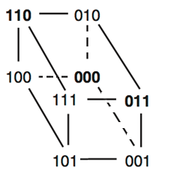
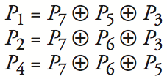
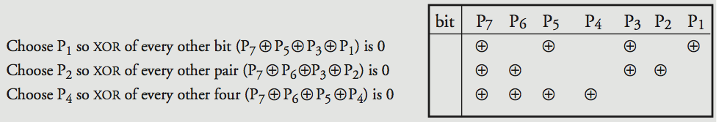
Examples
Example-1: simple parity check
  2 bits -> 3 bits
  Detect 1-bit errors
Example-2:
  4 bits -> 7 bits (56 using only extra 7)
    3 extra bits to distinguish 8 cases
  Correct 1-bit errors
    P4 P2 P1 in order, 1 has trouble

Slide 29
Erasure error (illegible bit)
  Know which bit is in question
  Can correct one bit by one extra parity check bit
Parity packet
  Similar as RAID-4
  4+1 add 25% network load
Use case
  Broadcasting packet （ more ）
  Controlling jitter in stream transmission
  When round-trip delays are too long

Slide 30
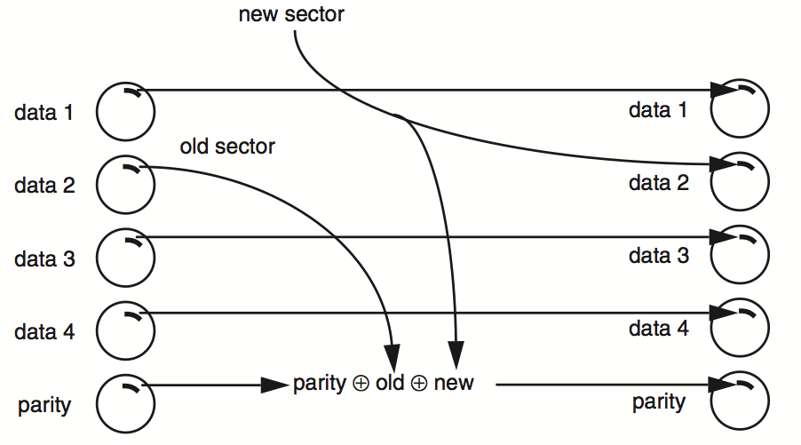
Incremental redundancy
Forward error correction in disk (RAID 4)
Incremental redundancy is not applicable sometimes
  E.g. encoding is preserved in arithmetic processing
  The only one can systematically protect data is …

Slide 31
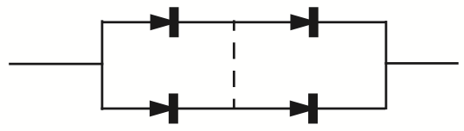
Replication: massive redundancy
Redundancy in bridge building
  Material strength: 5 or 10 times as strong as min
  Heavy-handed, but simple and effective
Replication
  Replicas: identical multiple copies
  Quad component by Shannon & Moore
  Can tolerate single short circuit and single open circuit, and others
  If the bridge is added, can tolerate more open circuits but less short circuits
  Mask failures silently

Slide 32

Voting
NMR: N-modular redundancy (supermodule)
  E.g. TMR (3MR) and 5MR
  Voter: compare the outputs with the same inputs
  Can be applied at any level of module
Fail-vote: 3MR with a majority voter
  Raise an alert if any replicas disagree with majority
  Signal a failure if no majority
  Fail-fast only if any two replicas fail in different ways
    If two replicas fail in same way, then not fail-fast

Slide 33

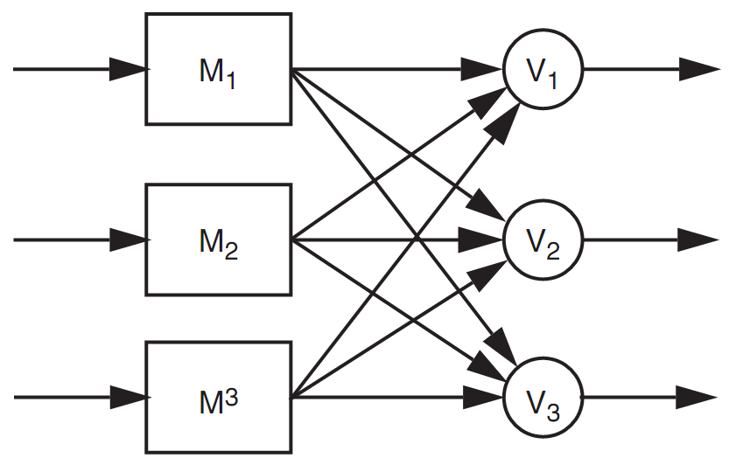
Voting
The probability that an incorrect result will be accepted by the voter is that it is no more than:
Assume that the voter is perfectly reliable, which is not pratical
  Voter should also be replicated
  Everything should be replicated
  Recursive: voters belong to
  next module
  Final voter should be the client

Slide 34

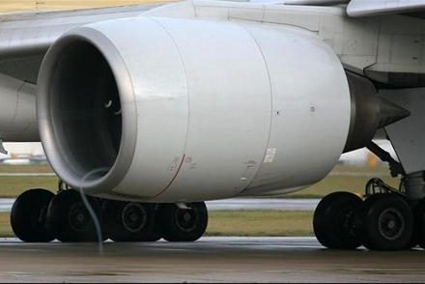
2wN
MTTF : 6000
1wN (MTTF: 6000) ×3

Slide 35
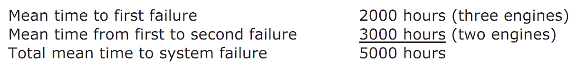
Voting
TMR can improve reliability
  If R(T) = 0.999, TMR’s R(T) = 0.999997
But MTTF can be smaller
  If MTTF is 6,000 hours and fails independently, and the mechanism of engine failure is memoryless
  6,000 hours in only 2,000 hours of flying, first fail
  3,000 hours next and cause the second fail
  5,000 hours < 6,000 hours

Slide 36
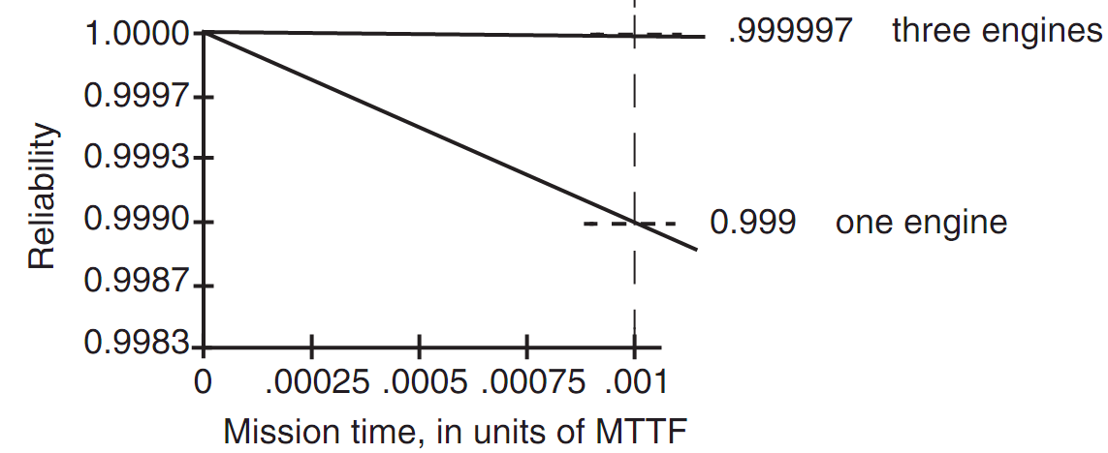
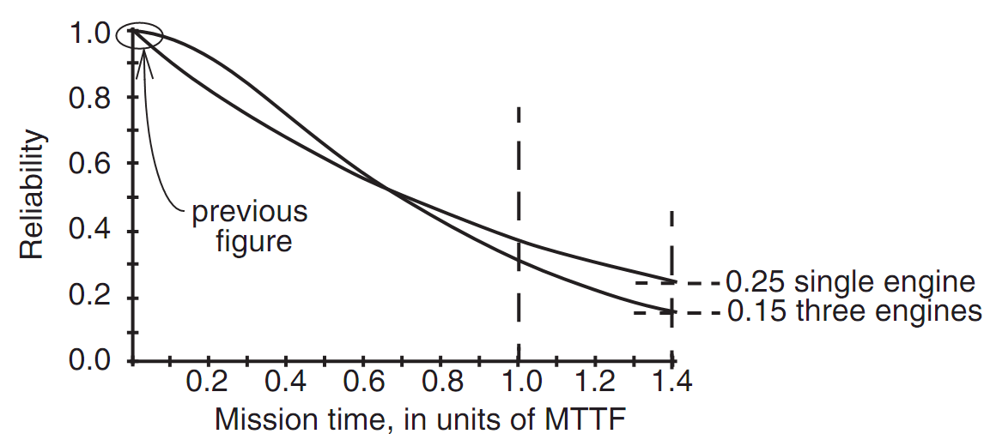

Slide 37



MTTF = 1000 h

Slide 38
MTTF-replica and MTTF-system
If MTTF-replica = 1, N replicas total
  Expected time until 1st failure is MTTF-replica/N
  Expected time from then until the 2nd is MTTF-replica/(N-1)
  Expected time until the system of N replicas fails is
  For large N is approximately ln(N)
If mission time is long compared with MTTF-replica
  To get MTTF-system multiply by K, cost is e^{K}
  Simple replication escalates the cost while providing little benefit

Slide 39
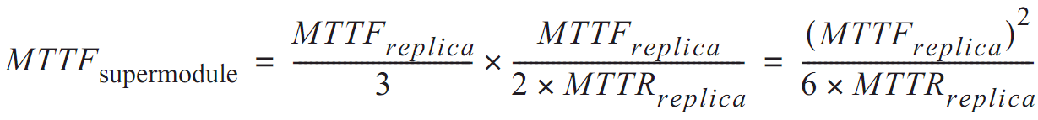
Repair
Return to fail-vote Tri-MR supermodel
  Requires at least two replicas be working
  The rate of failure of 2 replicas is 2/MTTF
  If replacement takes 1 hour, chance is 1/3000
  Once replaced, expect to fly another 2000 hours until the next engine failure
  If we have unlimited replacement for 10,000 hours

Slide 40
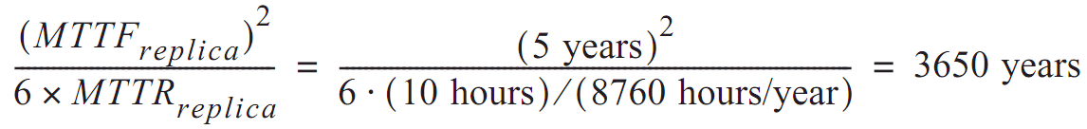
  MTTF = 6 million hours
In another word
  Although MTTF is reduced by the factor of 3
  The availability of repair has increased MTTF by a factor equal to the ratio of the MTTF to MTTR of the remaining 2 engines
Disk with 3 replicas
  If MTTF is 5-year, repair in 10 hours

Slide 41
Review overly optimistic assumptions
Disks fail independently
  Same vendor, same fault
  Earthquake, whose MTTF is less than 3650 years
Disk failures are memoryless
  Bathtub curve
Repair is also a memoryless process
  Stock enough spares?
Repair is done flawlessly
  Replace the wrong disk, forget to copy data, etc.

Slide 42
Masking transient errors
Masking of transient errors
  E.g. ALU, 1GHz, MTTR-replica = 1, TMR
    If MTTF-replica is 10^10 cycles, 1 error per 10 seconds
    Then MTTF-supermodule is 10^20/6, 500 years
  Why? the chance that 2 transient errors in the same cycle is small
Both directions
  If MTTF-replica drops 20 time, then only 1/400
  May share common errors

Slide 43
Variations of fail-vote
Purging
  If one replica disagree, call for repair and ignore its output
Pair-and-compare
  Create fail-fast by taking two replicas and compare
  Using off-the-shelf components, not specialized version
    Less time to design
    Massive production
NMR with fail-fast replicas
  If replicas is fail-fast (perhaps pair-and-compare)
  Then TMR can continue to run even 2 of its 3 fail
  So robust that N is seldom greater than 2

Slide 44
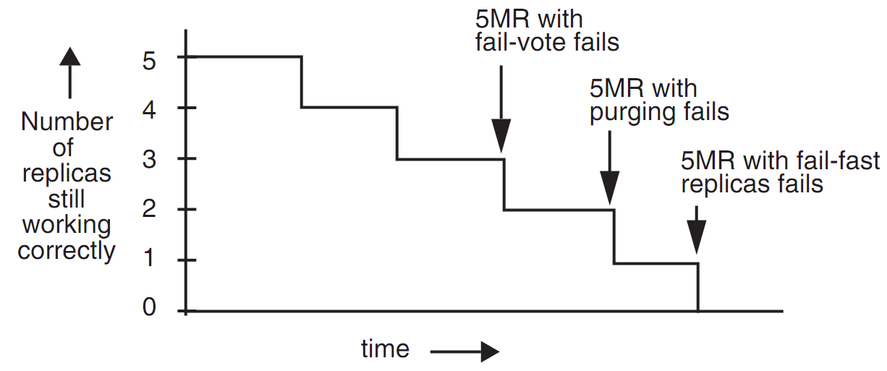
Variations

Slide 47
Partition
Partition
  One fast processor or two slower processors?
  E.g. N generators in electric power company

Slide 48
N+1 Redundancy
N+1 redundancy
  Modules are completely interchangeable, dynamically allocated, not used as storage
  E.g. processors, dial-up modems, airplanes, etc.
  Ensure the spare capacity is greater than the largest
  Storage is also possible: RAID-4

Slide 49
Continuous operation
Continuous operation
  When repair is part of the FT system
  Quickly identify failing component, remove, repair, reinstall without halting operation
    Hot swap
  Implications for software
    Configuration management anticipate hot swap ①
    Maintain state
      Periodic consistency checks on data
Notes:
Configuration management-----

Slide 50
Applying redundancy to software and data
Software and data
  Software: reduce the impact of programming errors
  Data: reduce the impact of any kind of hw, sw, or operational error that may affect integrity
  N-version programming, valid construction, firewall
Outline
  Tolerating software faults
  Tolerating soft (and other) faults by separating state
  Durability and durable storage
  Magnetic disk fault tolerance

Slide 51
Tolerating software faults
NMR requires independence among the replicas
  E.g. DNS software evolved for different OSes
N-version programming
  Commission several teams of programmers
  Run several versions in parallel and compare results
  Same training? Same language? Same ambiguities?
  Bit-for-bit identical results are difficult
  Boeing 777 aircraft (N=3) & Space Shuttle (N=2)
  Can also apply in hardware replica

Slide 52
Tolerating software faults
Valid construction
  Devising spec and programming tech that avoid faults in the first place
  Test tech that systematically root out faults
  Repaired once and for all before deploying
  Software: once it is made correct, it stay that way。But….
    Hard to get correct
    Changing is required
    Tension between valid construction and design for iteration
    Later maintainer may make things worse

Slide 53
Separating states
Residue of faults is inevitable
  Both software and hardware
Software’s states widely distributed in …
  Non-volatile storage, volatile memory, processor registers, kernel tables, etc.
  Makes containment of errors problematic
  Stop/repair/resume is usually unrealistic
Separating states into 2 categories:
  1. State that the system can safely abandon when fail
  2. State whose integrity the system should preserve despite failure

Slide 54
Separating states
Upon detecting a failure
  Abandon all state in the first category
  Just maintain the integrity of second category
  Starting a new set of threads with a clean states
    Working only with the second category
    Protect the integrity of the second category
Natural firewall
  Non-volatile storage: GET/PUT interface, as a bottleneck
  Volatile storage: READ/WRITE interface
  Stop the system before it reaches the next PUT
    Making the volatile storage the error containment boundary

Slide 55
Separating states
Two aspects
  State in volatile memory devices can vanish at any instant
    Recovery: when vanish, automatically launch new threads that start by restoring the data in non-volatile storage
  Protect the data in non-volatile storage using replication
Example: DNS
  If server fails, abandons the volatile memory and restarts
  Sometime, no PUT when online, only update offline
  More……… ?

Slide 56
Durability and durable storage
Durability
  How long a result of action be preserved after the action completes
1. Durability << than the lifetime of the
thread that created the data
  Place the data in volatile memory is enough
  E.g. CHDIR: change working directory
  E.g. registers and cache of a processor
2. Durability for times short compared with expected operational lifetime of non-volatile storage media
  Writing one copy of the data in the nonvolatile storage
  E.g. data in a cache that writes through to a non-volatile medium
  E.g. writing nonce to non-volatile memory in RPC
  E.g. temporary copies in word-processing system

Slide 57
Durability and durable storage
3. Durability for times comparable to the expected operational lifetime of non-volatile media
  Placing replicas of the data on independent instances of the non-volatile media
4. Durability for many multiples of the expected operational lifetime of non-volatile media
  Aka. preservation
  Copying data from one non-volatile medium to another before the first one deteriorates or becomes obsolete
  Also consider software’s lifetime

Slide 58
Magnetic disk fault tolerance
Three/four nested layers
  Raw storage, fail-fast storage, careful storage
  Optional: durable storage
Fail-fast storage
  In software first, then migrate to firmware of the disk controller
  Usually includes a RAM buffer
  Reason: easy to track the source of failure, not as memory

Slide 59
Magnetic disk fault modes
Mechanical wear and tear
A bumping may cause a head to hit the surface
  Head crush may also create cloud of dust
  Results in several sectors decaying: decay set
Electronic components in the controller age
  E.g. clock timing and signal detection circuits
  Cause previously good data to become unreadable, or bad data to be written
  Soft or hard errors
Seek error
  Arm moves to a wrong track

Slide 60
System faults
Two threats to the integrity of data from outside
  If the power fails in the middle of a disk write
    Sector maybe partly written
  If the OS fails during the writing
    Data could be affected, even if the disk is perfect and rest of the system is fail-fast
    All the contests of volatile memory are at risk

Slide 61

Raw disk storage
Untolerated error
  Soft error: dust particles on the surface of the disk
  Hard error: a spot on the disk may be defective
  Hard error: previously information may decay
  Seek error: read on the wrong track
  Power fails during a RAW_PUT, partly write data
  OS crashes during RAW_PUT and scribbles over disk buffer

Slide 62

Fail-fast disk storage
Detected errors
  FAIL_FAST_GET checks the error-detection code, simply reports status = BAD
  FAIL_FAST_PUT reads back and checks fail, also report status = BAD
  FAIL_FAST_SEEK reads track number in the first sector and finds not match, report status = BAD
  Caller of FAI L_FAST_PUT tells it to bypass the verification step, but next FAIL_FAST_GET should detect it
  Power fails during FAIL_FAST_PUT, later FAIL_FAST_GET should discover checksum fails (reserve of power is needed)
Untolerated errors
  OS crashed during FAIL_FAST_PUT and scribbles buffer
  The data of some sector decays that is undetectable (rarely)

Slide 63

Careful disk storage
Tolerated errors
  Soft read, write, or seek error
  Mask by repeatedly retrying until status = OK
  If retry count exceeds some limit, it gives up and reports
Detected errors
  Hard errors after several retry, by setting status = BAD
  Power fails during a CAREFUL_PUT
Untolerated errors
  Crash corrupts data
  Data decays undetectably

Slide 64
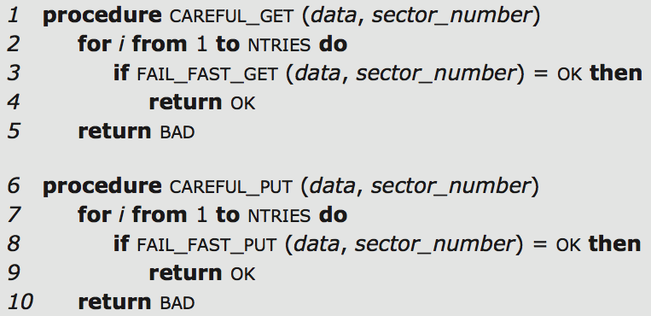
Careful disk storage
Revectoring
  Write data on a spare sector elsewhere on the same disk
  Add an entry to an internal disk mapping table
    Future GETs and PUTs use that spare one

Slide 65
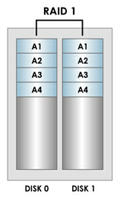
Durable storage: RAID 1
Errors on reading are detected by the fail-fast layer
  Only read one copy, unless its bad
Virtual sector number
  Usually involve different disks
Tolerate error
  Hard errors reported by careful layer are
  masked by reading from other replicas
Untolerated error
  Decay on the same sector of all the replicas, status = BAD
  OS crashes during a DURABLE_PUT
  Decay in a way that is undetectable

Slide 66
Improving on RAID 1
<number><number>
Clerk: periodically checks for decays
  T_{d} as the period, must short enough
Tolerated error
  Hard errors reported by careful layer are masked by reading from one of the other replicas
  Data of a single decay set decays, is discovered by the clerk, and is repaired, all within T_{d} of the decay event
Untolerated error
  The OS crashes during DURABLE_PUT
  All decay sets fail with T_{d}
  The data of some sector decays in a way undetectable

Slide 67
Detecting errors caused by system crashes
Outside help is need
  Either from OS or the application
  Calculates and includes an end-to-end checksum before initiating the disk write
  Any program checks first before using

Slide 68
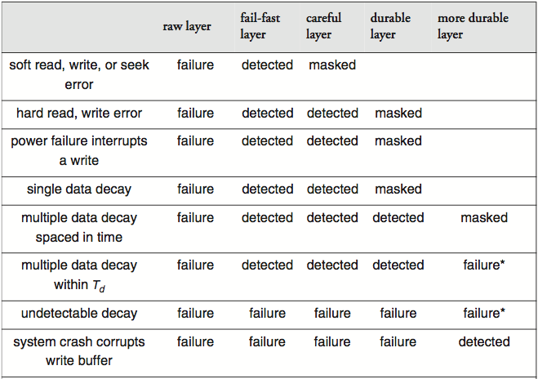

Slide 69
Still more threats to durability
Threats to data integrity
  Power fails in the middle of MORE_DURABLE_PUT
    Inconsistency between replicas, in chap-9
Physical disaster
  Fire, earthquake, flood, civil disturbance, etc.
  Delay replica writing
    Disks are quite reliable in the short term
    Separate in different location
    Increasing the risk of inconsistency
File system
  Using a overly simple disk failure model

Slide 70
Design strategies and design principles
Three particularly effective design strategies
  N-modular redundancy
  Fail-fast modules: sweeping simplification
  Pair-and-compare
Other principles
  Be explicit
  Design for iteration
  Keep digging
  Safety margin principle
  Avoid rarely used components

Slide 71
Design strategies and design principles
Different scenarios
  Computer-controlled radiation therapy machine
    Fault detection and fail-fast
    Masking faults may actually be a mistake
  Deep-space probe
    Failure masking to ensure mission success
  Telephone switch
    Needs many nines of availability
    Redial if disconnected
  Airline reservation system
    Users might tolerate short gaps
    Durability of its storage is vital
  Digital watch
    MTTF is long compared with the time until the watch is misplaced

Slide 72
How about the end-to-end argument?
End-to-end argument: a subsystem
  The subsystem needs not to do anything about errors
  Should not do anything might compromise other goals
    Low latency, high through-put, low cost
  Should let the higher layer decide
Counter arguments
  Ignoring an error allows it to propagate
  The lower layer know the nature of the error that it can mask it more efficiently
  Result: when the cost is small, error masking is usually done locally, and reporting event to a higher layer

Slide 73
More about reliable system
Security factors
  Faults caused by inconsistent, or malevolent, behavior
Byzantium faults
  Waits another to fail and adjusts its own output to be identical to the incorrect one
  Sends different result values to each of the voters
Heartbeats
  Keep servers running

Slide 74
A caution on the use of reliability calculations
Back-of-the-envelope calculations are enough
  Obsolete by rapid technology change
  Numbers predicted by formula can generate a false sense of confidence
  Suitable for stable technologies
  Reliability analysis is not a waste of time
    One must be cautious in applying its methods to CS

Slide 75
Application: FT model for CMOS RAM
CMOS RAM is low in cost and reliable
  No error masking in PC
Failures of CMOS RAM
  If noise affected only reads, detect and retry
  Need forward ECC for writing
Fault tolerant model
  p: probability that a bit is in error

Slide 76
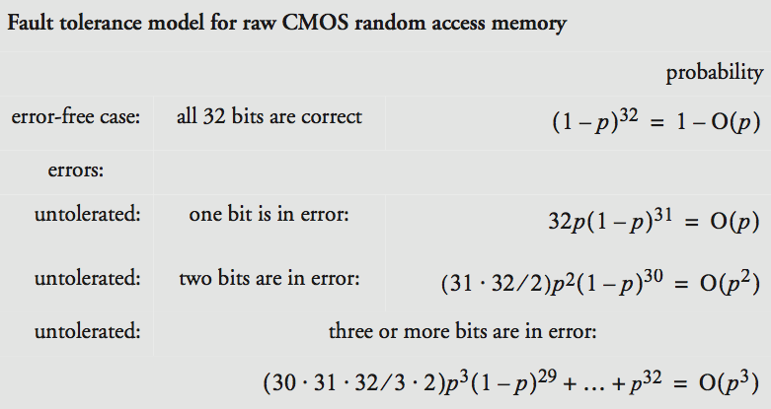
Fault tolerance model
<number><number>

Slide 77
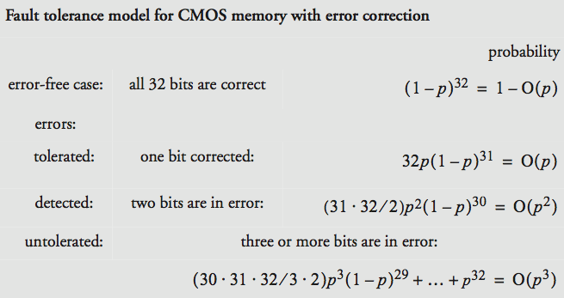
With error correction （Hamming distance is 3)

Slide 78
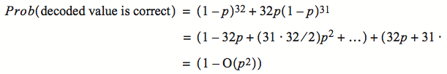
With error correction
Decoding algorithm
  Eliminate the errors of order p
  p^2 can be detected
  p^3 is negligible
Review two questions
  1. whether the estimate of bit error probability is realistic
  2. whether they fail independently?

Slide 79
"It's good to learn from your mistakes.
It's better to learn from other people's mistakes."
- Warren Buffett

Slide 80
Telehouse’s electricity
Telehouse was an “telecommunications hotel”
  Including most British Internet companies
    Safe against “fire, flooding, bombs, sabotage”
  Especial protection against power failure
    Including two independent connections to power grid
    A room full of batteries, two diesel generators
    Can detect failures automatically then switch
  May 8, 1997…
    “It was due to human error.”, which is not detectable
Lesson
  Identifing each potential fault and evaluate the risk is first step
  People are part of the system, mistakes made by authorized operators are typically a bigger threat than trees falling on power lines

Slide 81
M.I.T information services and technology
11 AM on April 2, 2004
  Power failure in W92, most services are restored
Later
  Power transition resulted in a power surge within UPS
  An internal surge protector was destroyed and started to smolder
After that
  Smoldering protector triggered the VESDA system
  Which triggered the fire alarm, and forced power down
Lesson
  A failure masking system not only can fail, it can cause a bigger failure than the one it is intended to mask

Slide 82
Kerosene light in Radin, Poland
A town of Radin has a electricity generator
  One day the machine broke
  Darkness descended upon all of the streets
  Even worse than the days without electricity
    Every house had a kerosene light
Lesson
  Single point of failure
    Centralization reduces robustness
    Adding redundancy to a centralized design takes planning and adds to the cost

Slide 83
The SOHO mission interrupt
SOHO spacecraft was lost on June 25, 1998
“… a direct result of operational errors, a failure to adequately monitor spacecraft status, and an erroneous decision which …”
  Five distinct direct causes of the loss
  Three indirect causes in design process
  Three indirect causes in operations procedures
Lesson
  Complex systems fail for complex reasons
  When some components are people, multiple failures are too common

